Slide 1
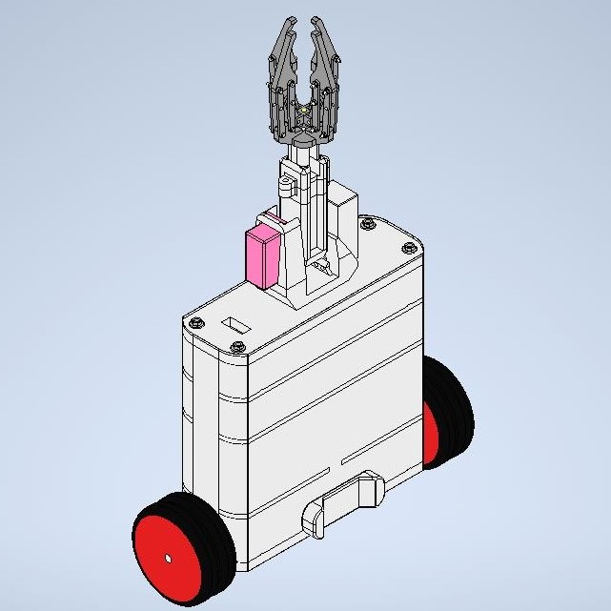
Presentation Overview
Problem definition
Literature survey
Objectives of the Project
Methodology
Summary of work done
Results Obtained
Gantt chart
Conclusion
References
figure 1. Two-wheeled self-balancing robot with robotic arm

Slide 2
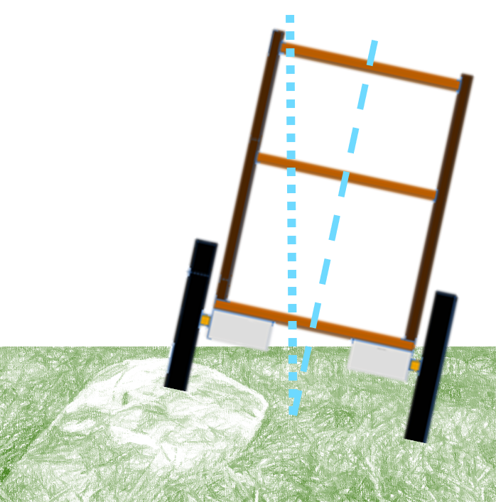
1. Problem Definition
Self balancing of a two wheeled robot on a flat, rough and dry surface is achieved using the application of inverted pendulum, which is a highly unstable system.
Environments such as agricultural fields bring in factors such as permissible angle of tilt and arbitrary disturbances into consideration while developing the self balancing model.
The challenge is to design the hardware considering the nature of the terrain and synchronize the control system in order to tackle the aforementioned arbitrary disturbances
figure 2. Illustration of tilting of the robot due to rocks

Slide 3
2. Literature Survey
Sl. No. | Authors | Title of the paper | Year of Publication
1 | Jasmin Velagic, Imran Kovac, Adis Panjevic, Adnan Osmanovic | Design and Control of Two-Wheeled and Self-Balancing Mobile Robot | 2021
2 | Hau-Shiue Juang, Kai-Yew Lum | Design and Control of a Two-Wheel Self-Balancing Robot using the Arduino Microcontroller Board | 2013
3 | Bernhard Mahler, Jan Haase | Mathematical Model and Control Strategy of a Two-wheeled Self-balancing Robot | 2013
4 | Osama Jamil, Mohsin Jamil, Yasar Ayaz, Khubab Ahmad | Modeling, Control of a Two-Wheeled Self-Balancing Robot | 2014
5 | Wei An, Yangmin Li | Simulation and Control of a Two-wheeled Self-balancing Robot | 2013
6 | Liang Sun, Jiafei Gan | Researching Of Two-Wheeled Self-Balancing Robot Base On LQR Combined With PID | 2010

Slide 4
Sl. No. | Authors | Title of the paper | Year of Publication
7 | Ricardo Santos Martins, Francisco Nunes | Control System for a Self-Balancing Robot | 2017
8 | Fuquan Dai, Xueshan Gao, Shigong, Wenzeng Guo, Yubai Liu | A two-wheeled inverted pendulum robot with friction compensation. | 2015
9 | Nguyen Gia Minh Thao, Duong Hoai Nghia, Nguyen Huu Phuc | A PID Backstepping Controller For Two-Wheeled Self-Balancing Robot | 2010
10 | Ejaz Ahmed, Ateeq ur Rehman, Owais Khan, Muhammad Haseed, Nihad Ali | Backstepping control design for two-wheeled self-balancing robot | 2018
11 | Sangtae Kim, Sang Joo Kwon. | Dynamic Modeling of a Two-wheeled Inverted Pendulum Balancing Mobile Robot | 2015
12 | Ali Ghaffari, Azadeh Shariati, Amir H. Shamekhi | A modified dynamical formulation for two-wheeled self-balancing robots | 2016

Slide 5
Sl. No. | Authors | Title of the paper | Year of Publication
13 | Zhe Wang | A Robust Control Method of Two-Wheeled Self-Balancing Robot | 2011
14 | Maki K | Modeling and Control of a Double Inverted Pendulum Using Lqr with Parameter Optimization through GA and PSO | 2020
15 | Ramashis Banerjee | Stabilization of Double Link Inverted Pendulum Using LQR | 2018
16 | S.Jadlovska | Classical Double Inverted Pendulum - a Complex Overview of a System | 2012
17 | Zakiya Amalia | State space control using LQR method for a cart-inverted pendulum linearised model | 2017
18 | Ahmad Taher Azar | Self-balancing Robot Modeling and Control Using Two Degree of Freedom PID Controller | 2019

Slide 6
Sl. No. | Authors | Title of the paper | Year of Publication
19 | Henrik Niemann | Design and analysis of controllers for a double inverted pendulum | 2004
20 | Qing-Rui Li | Stabilization Control of Double Inverted Pendulum System | 2008
21 | Narinder Singh | Comparison of LQR and PD controller for stabilization Double Inverted Pendulum System | 2012
22 | Wang Luho, Sheng Zhanshi | LQR-Fuzzy control for Double Inverted Pednulum | 2010
23 | Sandeep Kumar Yadav, Sachin Sharma, Narinder Singh | Optimal Control of Double Inverted Pednulum using LQR Contoller | 2012
24 | Knut Graichen, Michael Treuer, Michael Zeitz | Swing-up of the double pendulum on a cart by feedforward and feedback control with experimental validation | 2006
25 | Wei Zhong, Helmut Rock | Energy and Passivity Based Control of the Double Inverted Pendulum on a Cart | 2001
26 | Kamil Andrzejewski, Mateusz Czyzniewski, Maiej Zielonka | A comprehensive approach to double inverted pendulum modelling | 2019

Slide 7
Sl. No. | Authors | Title of the paper | Year of Publication
27 | Mandar R. Nalavade, Mangesh J. Bhagat, Vinay V. Patil | Balancing Double Inverted Pendulum on A cart by Linearization Technique | 2014
28 | Alexander Bogdanov | Optimal Control of a Double Inverted Pendulum on a Cart | 2004
29 | Haris Sheh Zad, Abasin Ulasyar | Adaptive Control of Self-Balancing Two-wheeled Robot System based on Online Model Estimation | 2023
30 | D T Ratnayake and M Parnichkun | LQR-Based Stabilization and Position Control of a Mobile Double Inverted Pendulum | 2020

Slide 8
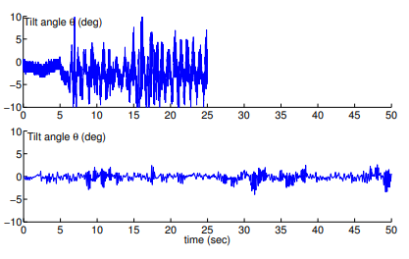
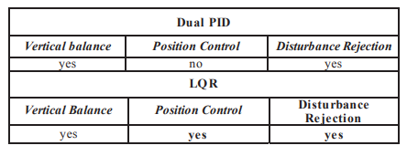
Summary of Literature Survey
A comparison was made between two control techniques: PID (Proportional-Integral-Derivative) and PI-PD (Proportional-Integral-Proportional-Derivative).
PI-PD control was found to produce more stable results compared to PID control.
PI-PD control was capable of improving C.G. (center of gravity) misalignment and enabling the robot to return to its original position.[2]
For mathematical modeling, Lagrangian and Kane methods exist. Amongst the two, Lagrangian is practical for the case of this research [5] [8] [11]
Two control methods, dual PID and LQR (Linear Quadratic Regulator), were used for comparison.
The results indicated that LQR was the superior approach when position and speed were more important factors to consider.[4]
figure.3 experimentally obtained history of tilt angle top graph is with PID and bottom graph is with PI-PD [2]
figure 4. Comparison results of Dual PID and LQR control systems, [4]

Slide 9
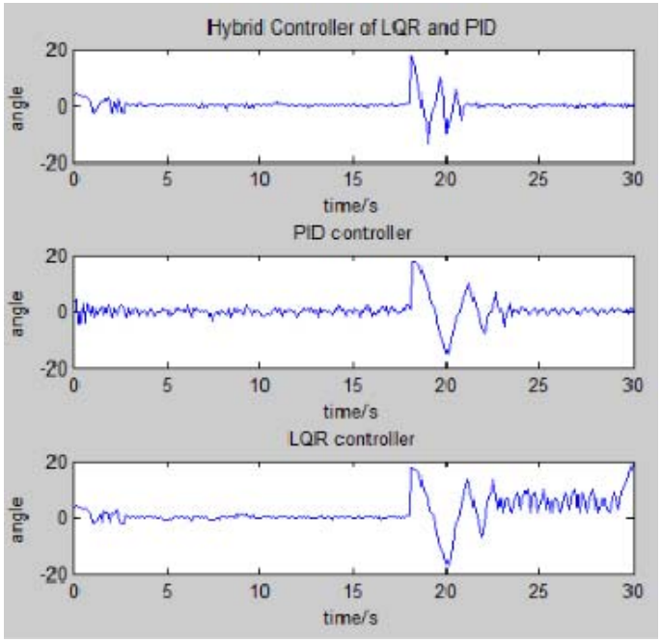
State space model approach can be utilized to format the input, for the closed-loop control system, from the derived governing equations [3], [16], [7]
Different control methods were compared, including a combination of LQR (Linear Quadratic Regulator) and PID, LQR alone, and PID alone.
Practical experimentation demonstrated that the LQR-PID controller provided an instant response and outperformed the other two controllers.
The LQR-PID controller was deemed as the best option for controlling the self-balancing robot based on the comparison of various control methods and experimental results.[6]
figure 5. Angle Vs time for LQR, PID
and Hybrid control methods [6]

Slide 10
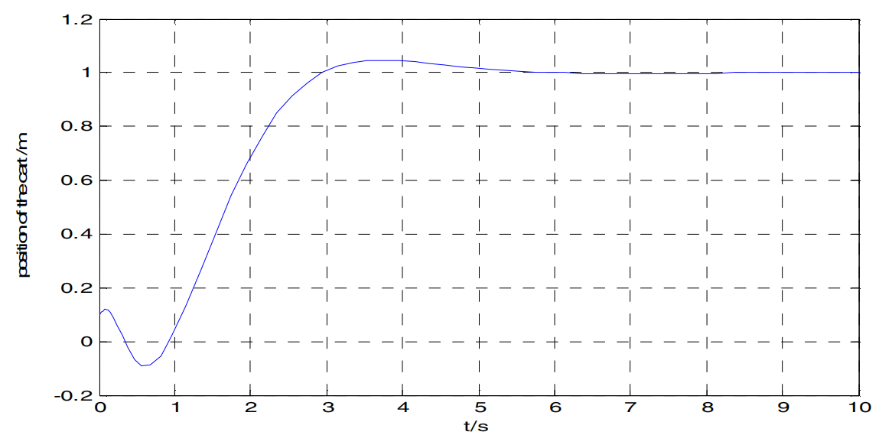
The self-balancing robot was controlled using two techniques: Pole-Placement and PID (Proportional-Integral-Derivative).
Pole-Placement control showed poor performance in terms of achieving the desired control objectives for the self-balancing robot.
The PID control was tuned and found to be more effective in meeting the requirements of the self-balancing robot.
A PID controller with dynamic reference adjustment method was implemented and was able to satisfy the requirements of the self-balancing robot effectively.[7]
The main focus if this paper is performance comparison between modern control and PD control for a double inverted pendulum system which is measured with respect to pendulum angles and cart position. [21]
The paper provides about the mathematical model then LQR-Fuzzy controller based on state variables.
The results show that LQR-Fuzzy logic controller not only has good stability, but also be able to make cart of the pendulum moving to the designed in advance place along the orbit [22]
Figure 6 . The position of the cart [22]

Slide 11
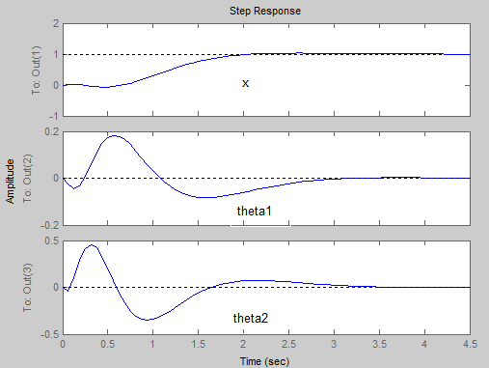
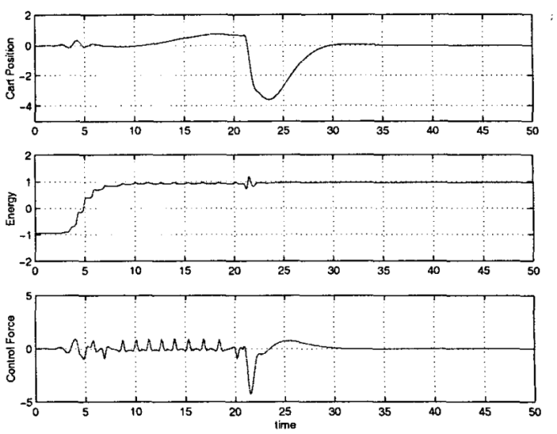
The paper conducted a systematic study on the performance analysis of the DIP system and simulation of LQR controller in MATLAB.
The LQR controller showed much better control. [23]
A new approach called feedback and feedforward controls are introduced and tested.
The paper emphasis on the experimental realization of DIP system which reveals the accuracy of this new control scheme [24]
The paper considers the design of a non-linear controller for DIP system which is based on passivity properties and energy shaping.
The simulation results show the effectiveness of the proposed nonlinear method. [25]
Figure 7. improved step response of the system [23]
Figure 8. Response of cart displacement, total energy and the control force. [25]

Slide 12
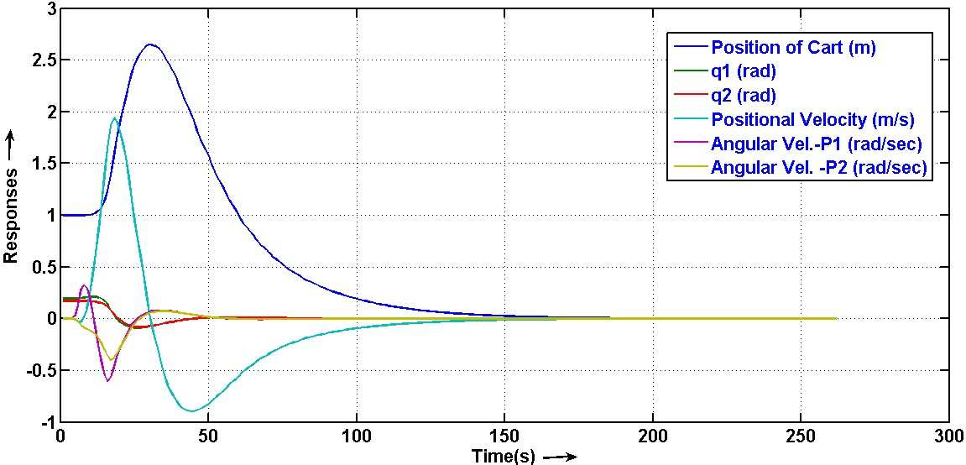
The paper aims to aggregate the knowledge on a DIP modelling using Euler-Lagrange formulae in presence of external disturbances and friction.
The results are drafted by the physical prototype construction. the investigation properties include stability of equilibria, the chaos of the DIP system and non-minimum behaviour of the upper position [26]
The study is done in stabilizing DIP system using LQR technique.
Linearization form of nonlinear system is obtained by Jacobian with proper cost function and the modelling of it is accomplished with the help of Euler – Lagrangian equation derived by specifying Lagrangian, difference between kinetic and potential energy of DIPC. [27]
This paper described the control force per the degree of freedom for the optimal control of the Double inverted pendulum system.
The LQR was considered as a baseline controller and other control designs were tested and compared against it.
Figure 9. Response of states v/s time [27]

Slide 13
Direct optimization using neural networks yield superior results to LQR [28]
The paper is on the design of an adaptive model predictive controller for the position control for a two wheeled self-balancing robot system.
The dynamic model of the system uses linear time variant to predict the future behaviour. the results show enhanced reference tracking and better stability using adaptive MPC controller than traditional LQR or PID controllers. [29]
The paper evaluated the control performance of the DIP system using LQR based stabilizing scheme by controlling the position of the system.
The results infer that the gain matrices from the simulation and experiments show similarity in each gain except corresponding to wheel and pendulum angular velocities and also concludes that it showed successful balancing of body and pendulum at upright position using LQR. [30]

Slide 14
The LQR (Linear Quadratic Regulator) control gains were enhanced using optimization techniques such as Genetic Algorithms (GA) and Particle Swarm Optimization (PSO).
The optimization techniques aimed to improve the performance of the LQR controller by finding optimal gain values.
As a result of the optimization, the pendulum in the system was able to stabilize within 3 seconds.
However, there was a maximum overshoot of 20 degrees, indicating some deviation from the desired setpoint. [14]
The CIPS (Cart Inverted Pendulum System) dynamic model was analyzed using the Lagrangian approach.
The simulation involved varying the weights Q and R values to achieve stability of the CIPS system.
When the R value (the weight assigned to the control signal) was large, the controller prioritized energy consumption, leading to stable behavior.
On the other hand, when the R value was small, the controller penalized the control signal, potentially improving precision but possibly sacrificing energy efficiency.
The choice of Q and R values in the LQR controller plays a significant role in attaining stability and desired performance for the CIPS system.[17]

Slide 15






3. Objective of the Project
To develop a inverted pendulum self-balancing robot for application in uneven terrain
To develop the robotic arm with gripper for harvesting application

Slide 16


















4. Methodology
1. Derivation of the governing equations of motion
5. Testing and validation of the prototype
2. Development of the control system
4. Fabrication of the prototype
3. Design development
1. Derivation of the governing equations of motion
5. Testing and validation of the Prototype
3. Development of the Design
2. Development of the control system
4. Fabrication of the prototype
Iteration 1 – Simple Inverted Self-balancing robot (SBR) model
Iteration 2 – Double Inverted Pendulum SB-Robot

Slide 17
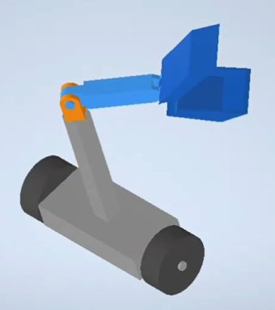
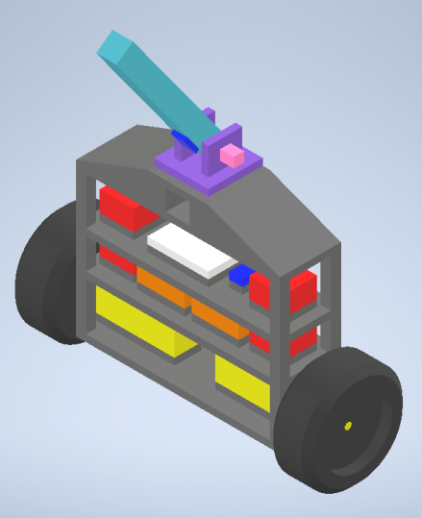
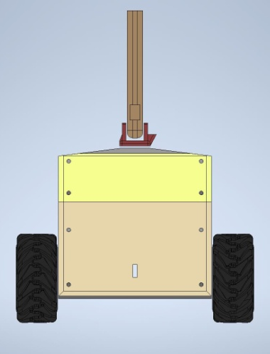
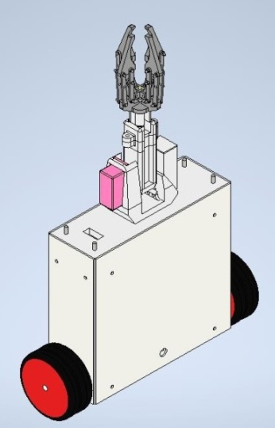

5. Work done
5.1 Prototype Design evolution
figure 10. Illustration of 3D Self-Balancing
figure 11. Simplified draft of the robot
figure 12. 3D Printable Prototype Design
(Mk3 Version)
figure 13. Wood-sheet machining Prototype Design
(Mk6 Version)
figure 14. Wood-sheet machining Prototype Design
(Mk7 Version)

Slide 18
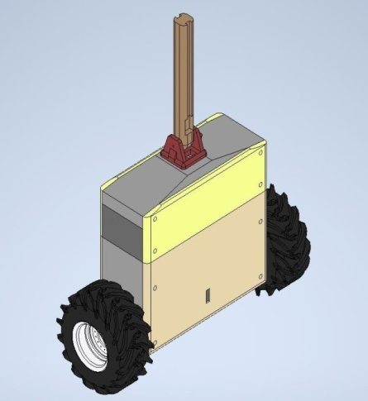

5.2 Comparison of fabrication techniques
S. No | Parameter | 3D Printing (Mk 3) | Wood Machined Sheet Fabrication (Mk 7)
1 | Illustration
2 | Bare Structural weight of the robot | 3.45 Kg | 2.2 Kg
3 | Total weight of the robot | 5.6 Kg | 3.8 Kg
4 | Materials cost for fabrication | Rs. 3,500 | Rs. 1,500
5 | Outsourcing cost | Rs. 51,000 | Rs. 7,500
6 | Total Cost of fabrication | Rs. 54,500 | Rs. 9,000
7 | Fabrication time | (If only 1* CR10 3D Printer is available) 20 Days | 2 Days

Slide 19
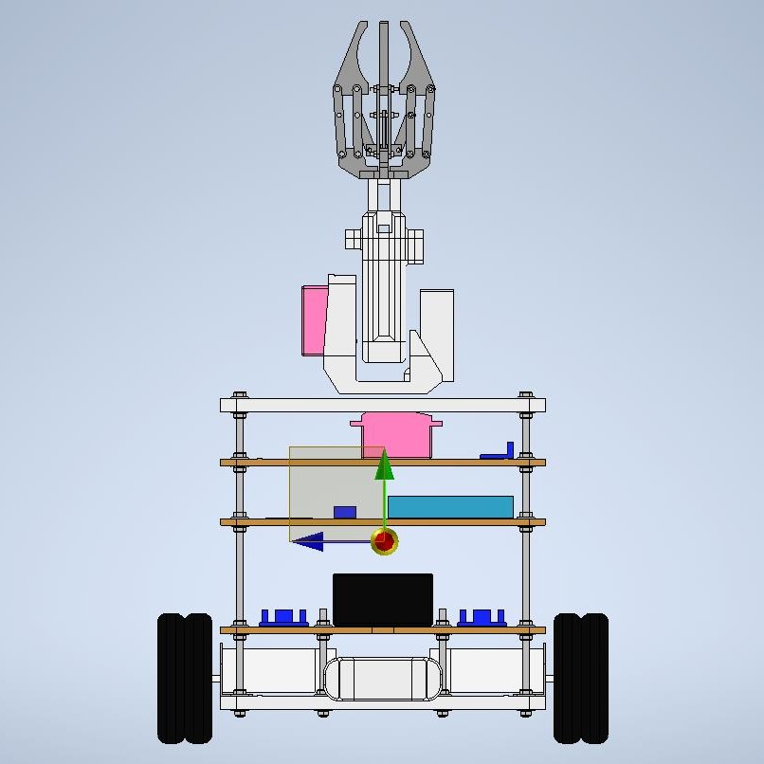
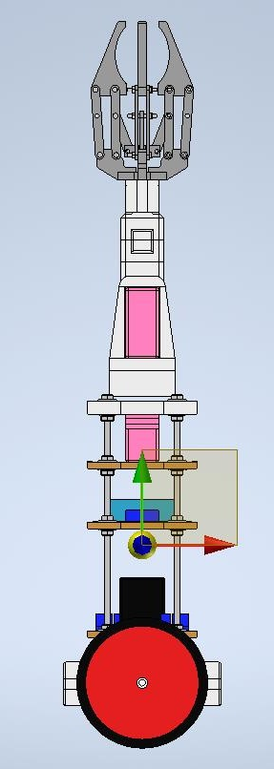
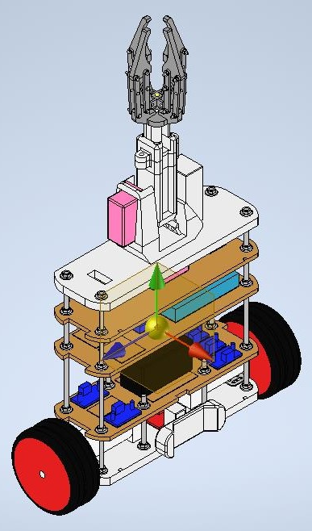
5.3 Wood Machined Sheet Fabrication (Mk7) Version
(a)
(b)
(c)
Figure 15. Illustration of the structural design of the robot – (a) Front view; (b) Side view; (c) Isometric view

Slide 20
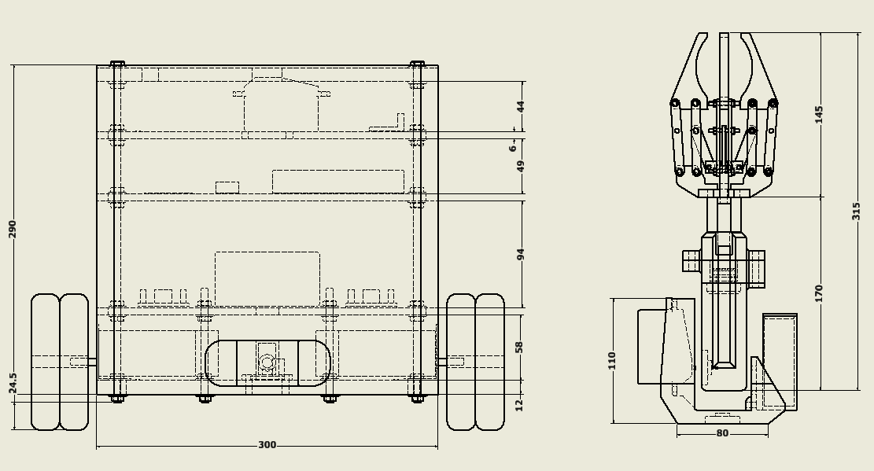
figure 16. Dimensional details of the robot’s design

Slide 21
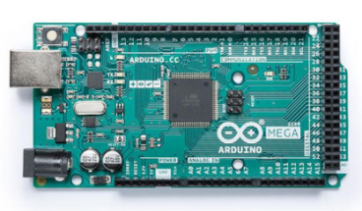
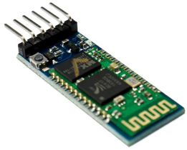
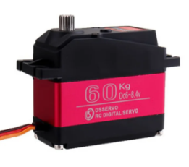
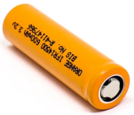
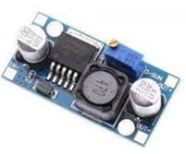
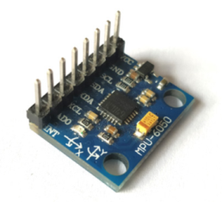
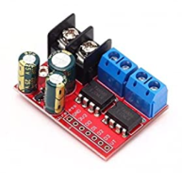
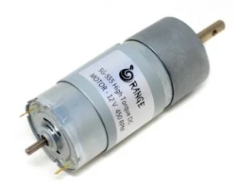
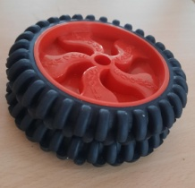
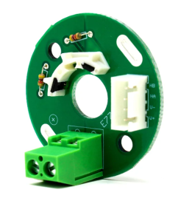
3D Printed Four-claw gripper
Arduino Mega
3D Printed Robotic Arm
3D Printed Pan and Tilt joint
HC-05 Bluetooth Module
7.4V 60Kg.cm Ultra torque servo motor
Illustration of the centre of gravity
12mm thick WPC Board
14.8 V Rechargeable Li-Ion battery
6mm thick MDF Board
M6 300mm Rod
Buck Convertor
6-Axis motion sensor – MPU6500 Gyroscope
TA6586 (two-motor-driver)
Orange OG555 High Torque DC Motor 500 RPM 45.8 N-cm
125mm Diameter wheels
OE37 Hall effect magnetic encoder
3D Printed Stand
figure 17. Illustration of the components used in the robot

Slide 22
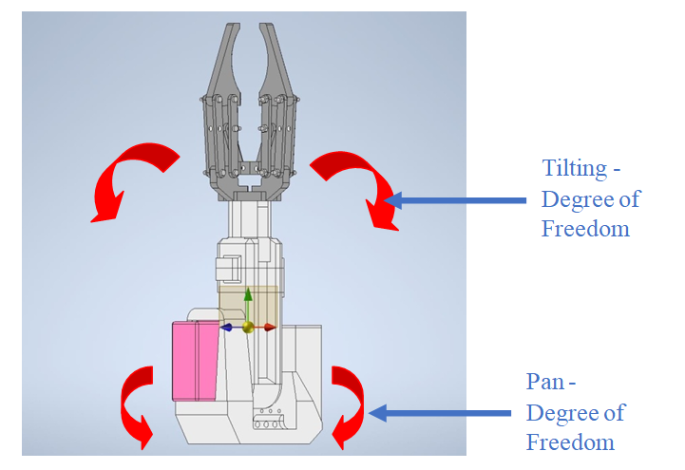
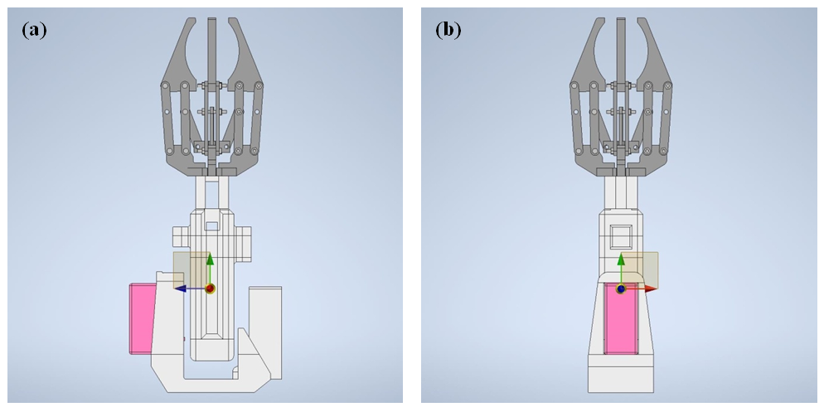
5.4 Robotic Arm and Four-claw gripper
figure 19. Illustration of the robotic arm and its centre of gravity location
figure 18. Illustration of the robotic arm and its degrees of freedom

Slide 23

Video 1. Illustration of Pan and Tilt joint motion of the robotic arm

Slide 24
The torque requirements of this robotic arm were identified though the following kinetics calculations:
Torque requirements for the tilt joint’s motor:
Length of the link of the robotic arm | = 15 cm
Length of the gripper | = 14 cm
Total length of the robotic arm | = 29 cm
Distance of the center of gravity of the link and the gripper from the axis of rotation of the tilt joint | = 21 cm
Weight of the link | = 110 g
Weight of the gripper | = 95 g
Weight of the servo motor and the fasteners | = 40 g
Maximum weight of the payload | = 500 g
Total load applied on the tilt joint | = 745 g
(i.e., 110 g + 95 g + 40 g + 500 g = 745 g = 0.745 Kg)
Torque required for tilt joint motor to operate tilting action | = 0.745 Kg X 21 cm
 | = 15.645 Kg.cm

Slide 25
Torque requirements for the pan joint’s motor:
Maximum distance of the center of gravity of the pan joint from the axis of rotation | = 6.7 cm
Weight of the pan joint | = 235 g
Weight of the tilt joint, which transfers on to the pan joint | = 245 g
Maximum weight of the payload | = 500 g
Total load applied on the tilt joint | = 980 g
(i.e., 235 g + 245 g + 500 g = 980 g = 0.98 Kg)
Torque required for pan joint motor to operate pan action | = 0.98 Kg X 6.7 cm
 | = 6.56 Kg.cm

Slide 26
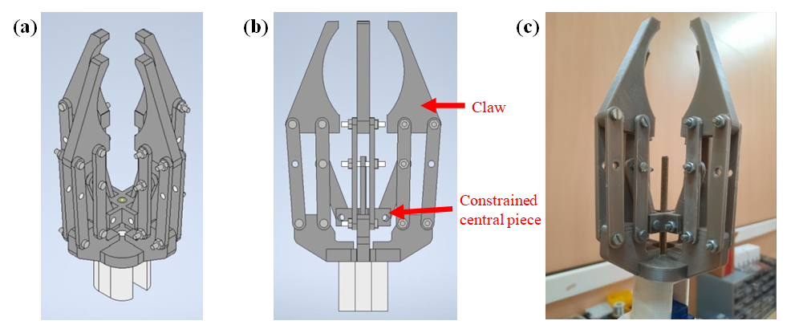
figure 20. Illustration of the four-claw-gripper – (a) Isometric view; (b) Side view; (c) Picture of the four-claw gripper with its driving bolt

Slide 27
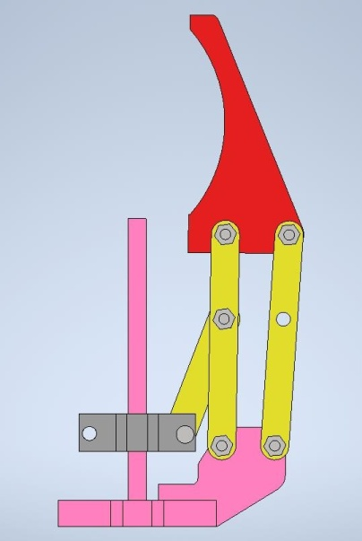
The kinematics of this mechanism is solved as follows:
In order to identify the number of degrees of freedom for each finger of the gripper Kutzbach criteria was used.
M = 3(n – 1) – 2j₁ – j₂
Where,
M = No. of degrees of freedom
n = Total no. of links
j₁ = No. of lower link-pairs (i.e., links which have surface contact at their joint. E.g. revolute joint or fixed joint etc.)
j₂ = No. of higher link-pairs (i.e., links which have line or point contact at their joint. E.g. spherical joint etc.)
figure 21. Illustration of a finger of a gripper

Slide 28
here,
n = 6
j₁ = 7
j₂ = 0
M = 3(6-1) – 2(7) – 0
M = 1
Therefore, the no. of degrees of freedom for each finger of the gripper in one, i.e., constrained movement in a single plane.
Video 2. Illustration of thr gripping and un gripping of the four-claw gripper

Slide 29
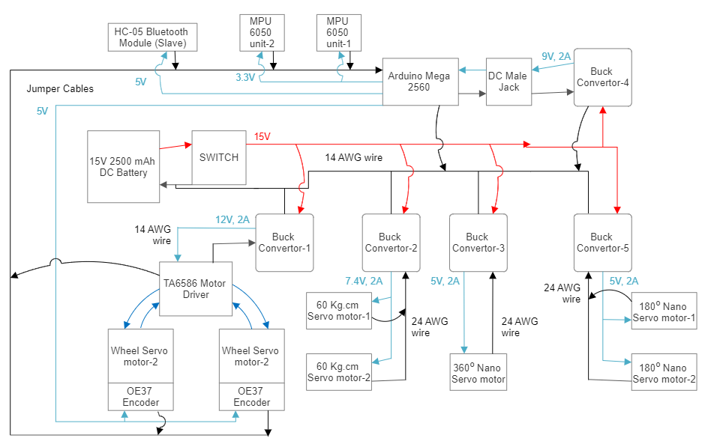
5.5 Integrated Circuit diagram for the robot and the robotic arm
figure 22. Integrated electrical circuit diagram of the robot and the robotic arm

Slide 30
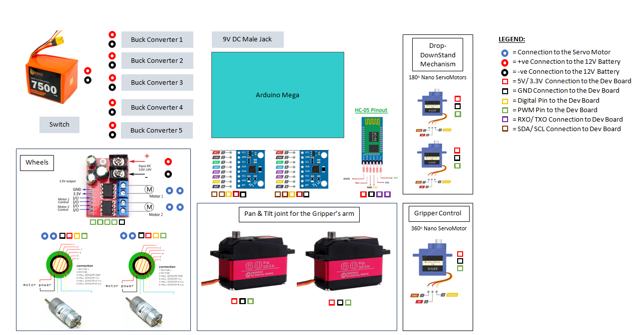
No. of 5V output Pins = 2
No. of 3.3 V Pins = 1
No. of GND pins = 3
No. of PWM Pins = 11
No. of Digital Pins = 4
No. of RXD pins = 1
No. of TXD pins = 1
No. of SDA pins = 2
No. of SCL pins = 2
figure 23. Sensors Input-Output ports diagram for the robot and the robotic arm

Slide 31
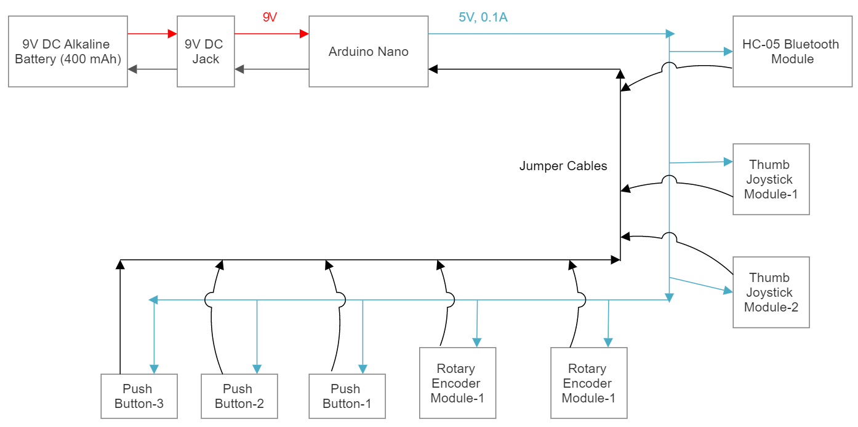
5.6 Circuit diagram for the console
figure 24. Circuit diagram of the console

Slide 32
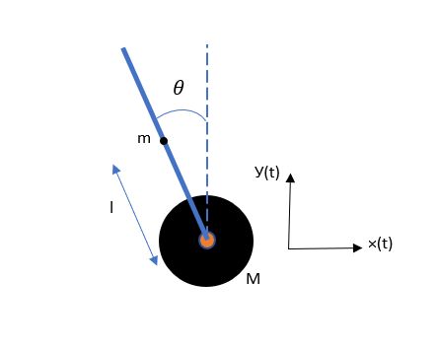


5.7 Mathematical Model
Derivation of the governing equation:
The horizontal displacement of the cart, with time t being the reference, is represented by:
x₀ (t) (1)
The horizontal displacement and the vertical displacement of the center of the pendulum, with time t being the reference, is represented by:
The difference between the total kinetic energy and the total potential energy of the system is given by the Lagrangian (L), which is represented by:
figure 25. Free Body Diagram of a Simple Inverted Pendulum

Slide 33

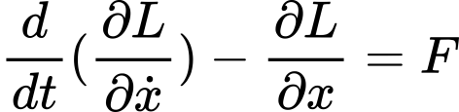
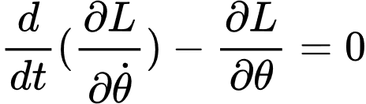
where, K.E represents the total kinetic energy of the system and P.Erepresents the total potential energy of the system
The kinetic energy of the system is represented by
The potential energy of the system is represented by:
accordingly, L can be obtained as
Equations that represent the dynamics of the system are given by

Slide 34
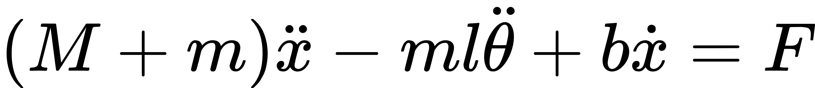
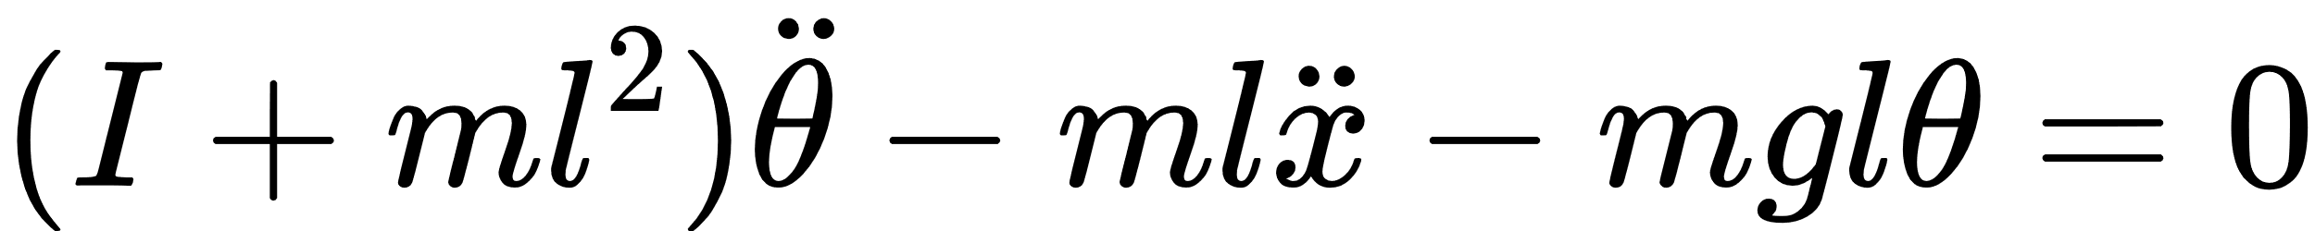
The equations are
Where,
m = mass of the pendulum
M = mass of the wheels
Also adding the friction(b), and moment of inertia of the system(I) the final equations of motion becomes

Slide 35
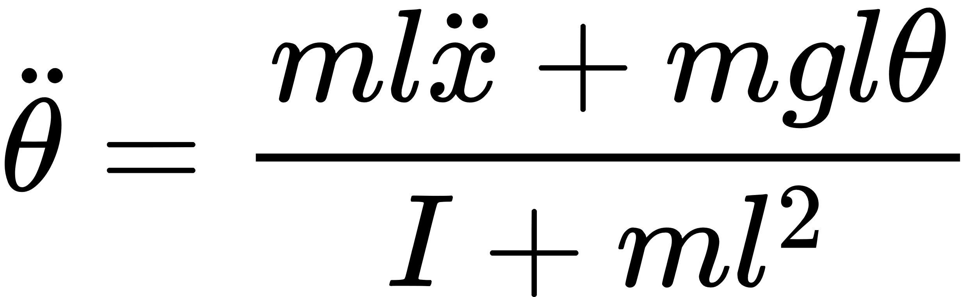
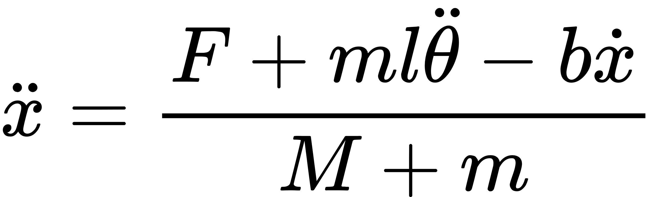
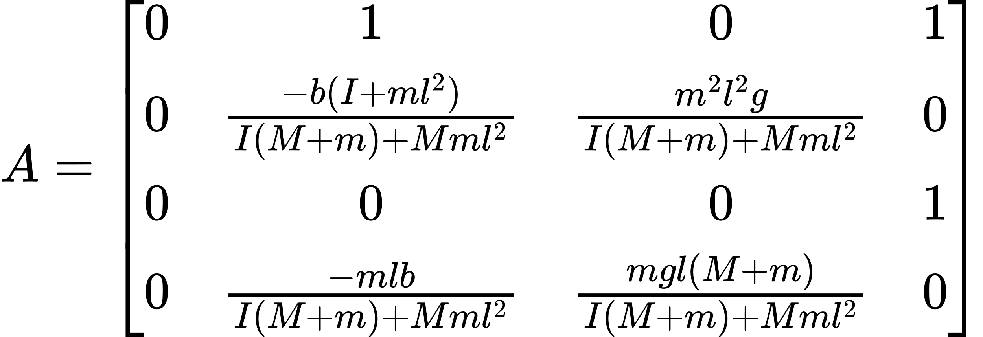
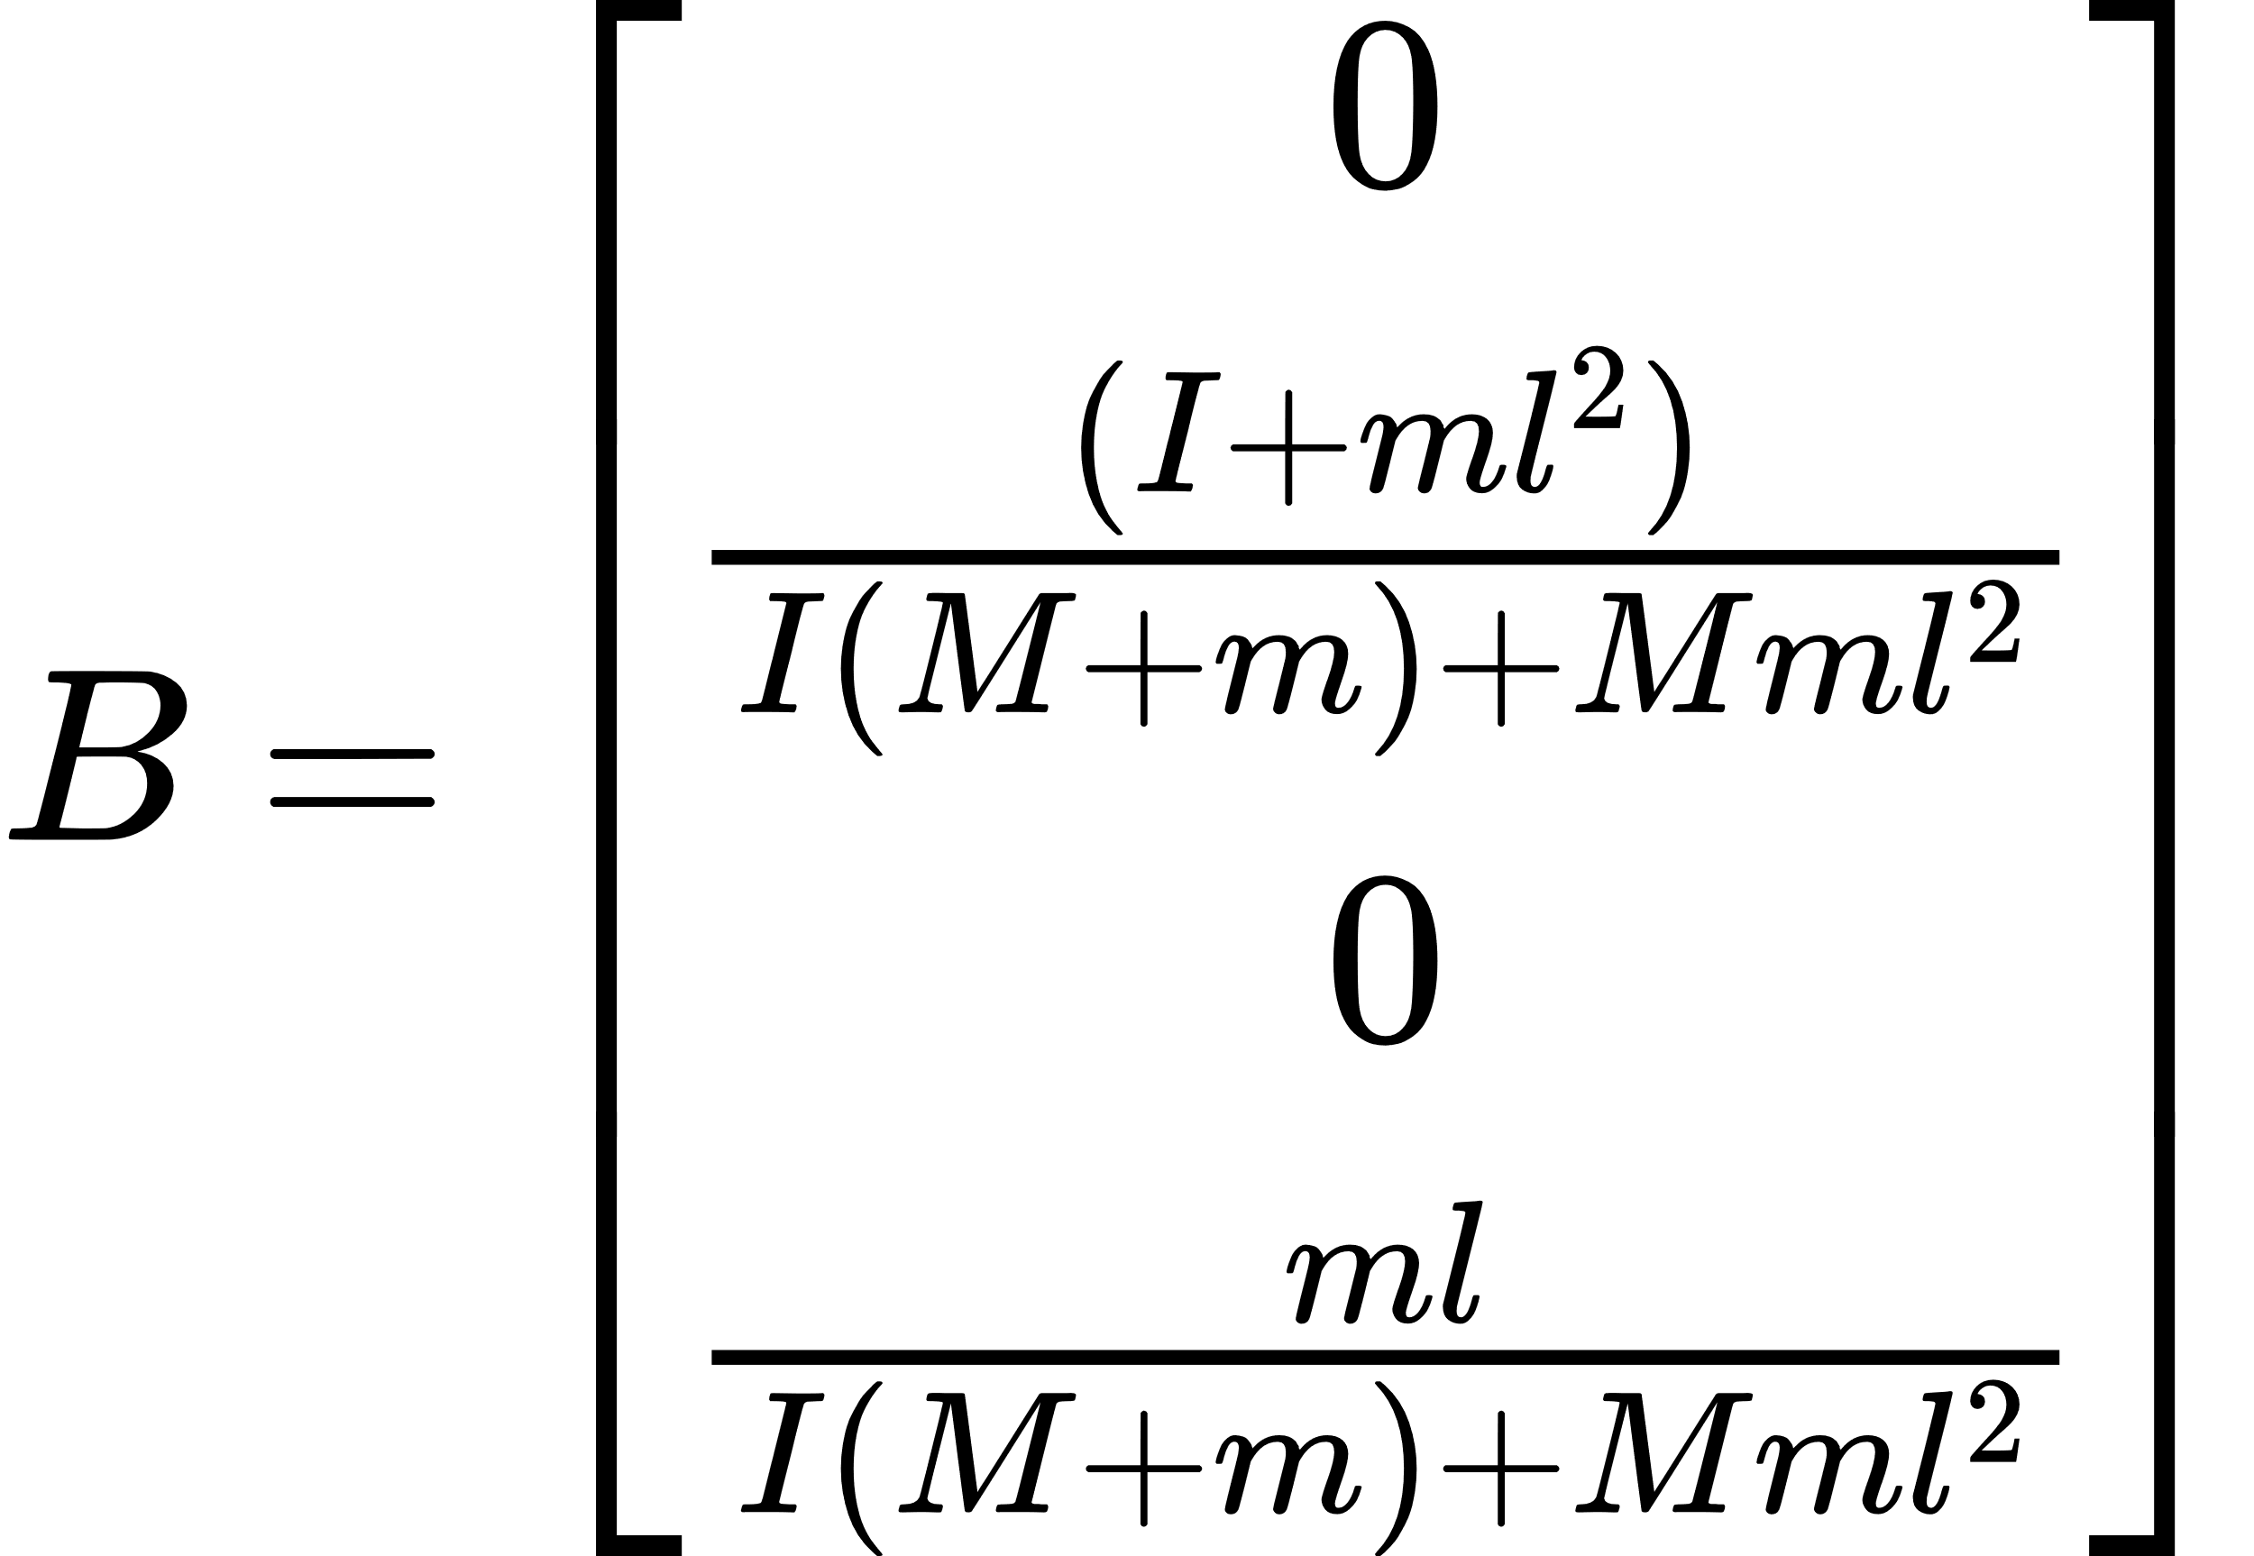
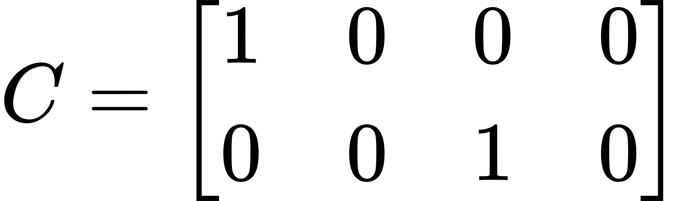
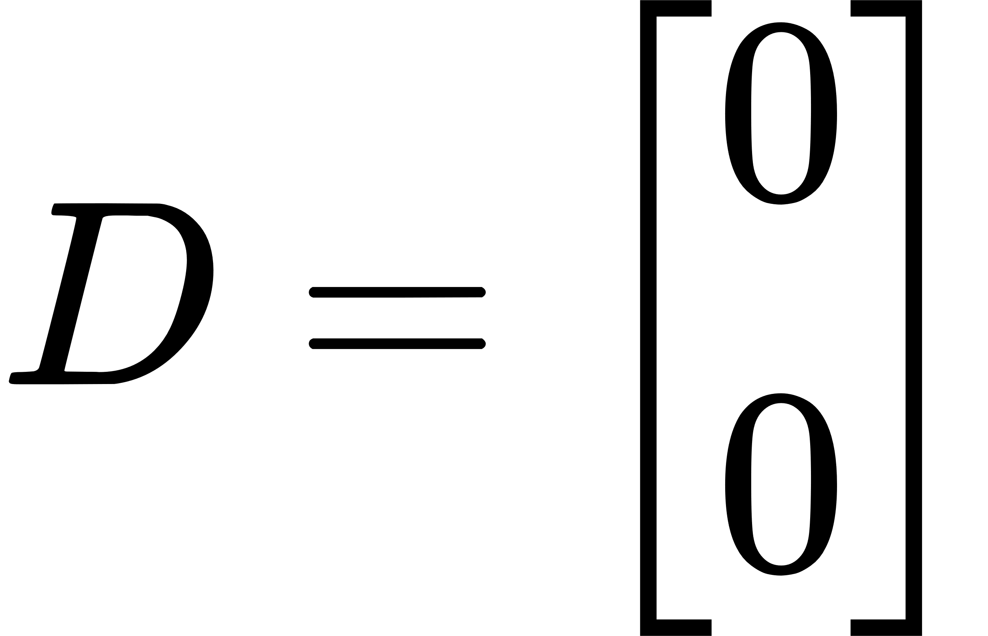
Applying State space model:
By applying linearization to the governing equations of motion and rearranging them we get
From this equations we get the state space equations as follows

Slide 36



5.8 Implementing the Control system
Table 3 Parameters of the inverted - pendulum
Description of the parameter | Magnitude value | Unit
Mass of the wheels, m | 0.6 | Kg
Mass of Pendulum, M | 3.8 | Kg
Earth’s gravity, g | 9.81 | m/s²
Centre of gravity of pendulum, l | 0.120 | m
Moment of inertia of the rod, I | 0.02050 | kgm²
Friction coefficient | 0.1 | Ns/m

Slide 37
5.9 Simulation Methodology
Simulation of pole-placement control technique:
The desired pole of the system are[-1.0+1.36i, -1.0-1.36i, -4.9, -5]. And the gains are calculated using the place function of MATLAB. The gain matrix is as follows
K_pole = [-1.7650, -2.0519, 55.1395, 3.2635]. The system is simulated using the gain matrix and the results are recorded.
Simulation of LQR control technique:
The weight matrices that have been used for calculating are given below
Q = diag([150,50,200,10])
R = 0.01
The values have been taken such that more penalty is applied when the system is not in the required position and upright
To obtain the gain matrix K_LQR the LQR function of MATLAB is used
The gain matrix obtained from this is:
K_LQR = (-12.2474, -15.0435, 112.5687, 10.5238)

Slide 38
6. Results Obtained
6.1 Responses of the system from the Pole-placement control technique
(a)
(b)
Figure 26 The response Pole-placement control (a) The change in position of the cart with respect to time, (b) The change in the angle with respect to time.

Slide 39
6.2 Responses of the system from the LQR control technique
(a)
(b)
Figure 27 The response of LQR control (a) The change in position of the cart with respect to time, (b) The change in the angle with respect to time

Slide 40
6.3 ANALYSIS OF THE RESPONSES AND DISCUSSION
Table 4 The simulation results of Rising time, Settling time for the cart, angle , in seconds
 |  | Pole-placement control technique Time (s) | LQR control technique Time (s)
For angle | T_{r} | 0 | 4.4409e-16
 | T_{s} | 5.1326 | 3.6574
For position x | T_{r} | 1.1821 | 1.6409
 | T_{s} | 3.9312 | 2.7590

Slide 41
(a)
(b)
Figure 28 (a) The step response of LQR control, (b) The step response of pole-placement control

Slide 42
6.4 Tests conducted on the prototype
6.4.1 Testing Single inverted pendulum
Video 3. Single inverted pendulum configuration – implemented with 300 RPM - Instability
Video 4. Single inverted pendulum configuration – implemented with 300 RPM and auto-deployment of stands based on the angle of tilt of the robot - Instability
Video 5. Single inverted pendulum configuration – implemented with 100 RPM with stands deployed

Slide 43
6.4.2 Testing Single inverted pendulum with Robotic arm
Video 6. Single inverted pendulum with robotic arm – implemented with 150 RPM – Vibrations in the robotic arm
Video 7. Single inverted pendulum with robotic arm – implemented with 100 RPM and restricted Pan-joint

Slide 44
6.4.3 Testing Single inverted pendulum with Robotic arm in uneven terrain
Video 8. Single inverted pendulum with robotic arm – implemented with 100 RPM and restricted Pan-joint – Test on uneven terrain

Slide 45
7. Gantt chart
 |  | Dec 2022 | Jan 2023 | Feb 2023 | Mar 2023 | Apr 2023 | May 2023
1] | Literature Review
2] | Derivation of governing equations of motion
3] | Development of the control system
4] | Design development
5] | Fabrication of the prototype
6] | Testing and validation of the prototype
Orange box: Planned; Light Red box: Delay;
Dark Red box: Future Scope of work
Current status

Slide 46
8. Conclusion & Future scope of work
An in-situ working prototype of the single inverted pendulum is fabricated and tested
From the simulation results, it can be comprehended that the LQR control technique shows better responsiveness in attaining stability over the Pole-placement and PID technique
For the selected system, the settling time for the outer pendulum in LQR scheme is observed to be three times shorter compared to the pole placement technique.
This indicates that LQR scheme can be adopted for controlling systems that require faster settling time

Slide 47
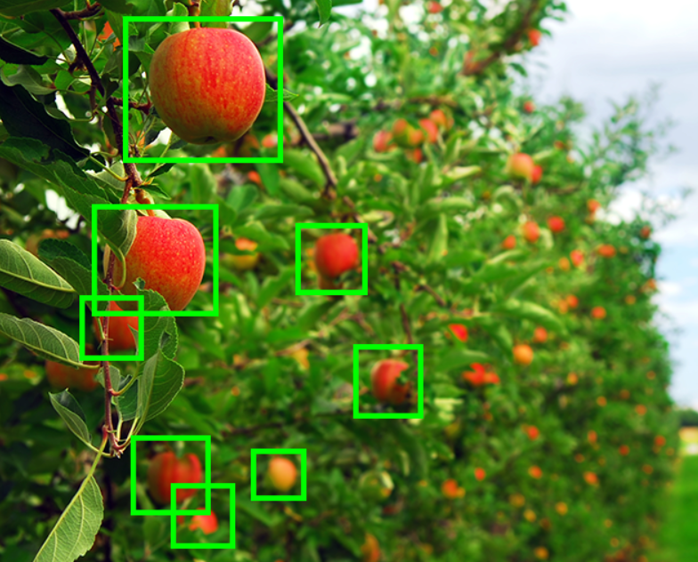
Future Scope of work
Scaling Down the Prototype
Computer Vision & Ai
On-board Data Storage
Telescopic Robotic arm
Figure 29 Computer vision for autonomous harvesting using robotic arm and its gripper
Source: roptracker.com/images/blog/Robots_in_Ag/computervision.webp

Slide 48
References
[1] Hau-Shiue Juang, Kai-Yew Lum. Design and Control of a Two-Wheel Self-Balancing Robot using the Arduino Microcontroller Board. 10th IEEE International Conference on Control and Automation, 2013.
[2] Jasmin Velagic, Imran Kovac, Adis Panjevic, Adnan Osmanovic. Design and Control of Two-Wheeled and Self-Balancing Mobile Robot. Conference - Proceedings, 2021, doi: 10.1109/ELMAR52657.2021.9550938.
[3] Bernhard Mahler, Jan Haase. Mathematical Model and Control Strategy of a Two-wheeled Self-balancing Robot. IEEE, 2013, doi: 978-1-4799-0224-8/13.
[4] Osama Jamil, Mohsin Jamil, Yasar Ayaz, Khubab Ahmad. Modeling and Control of a Two-Wheeled Self- Balancing Robot. IEEE International Conference on Robotics, 2014.
[5] Wei An, Yangmin Li. Simulation and Control of a Two-wheeled Self-balancing Robot. IEEE International Conference on Robotics and Biomimetics, 2013.
[6] Liang Sun, Jiafei Gan. Researching Of Two-Wheeled Self-Balancing Robot Base On LQR Combined With PID. IEEE, 2010, doi: 978-1-4244-5874-5/10.

Slide 49
[7] Ricardo Santos Martins, Francisco Nunes. Control System for a Self-Balancing Robot. In International Conference, University of Algarve, June 2017 - Proceedings, 2017.
[8] Fuquan Dai, Xueshan Gao, Shigong, Wenzeng Guo, Yubai Liu. A two-wheeled inverted pendulum robot with friction compensation. Mechatronics, vol. 30, 2015, pp. 116 - 125.
[9] Nguyen Gia Minh Thao, Duong Hoai Nghia, and Nguyen Huu Phuc. 2010. A PID Backstepping Controller For Two-Wheeled Self-Balancing Robot. IFOST 2010 - Proceedings. IEEE, 2010.
[10] Ejaz Ahmed, Ateeq ur Rehman, Owais Khan, Muhammad Haseed, Nihad Ali. Backstepping control design for two-wheeled self-balancing robot. IEEE, 2018.
[11] Sangtae Kim, Sang Joo Kwon. Dynamic Modeling of a Two-wheeled Inverted Pendulum Balancing Mobile Robot. International Journal of Control, Automation, and Systems, vol.13, pp. 926 – 933, 2015. doi: 10.1007/s12555-014-0564-8.
[12] Ali Ghaffari, Azadeh Shariati, Amir H. Shamekhi. A modified dynamical formulation for two-wheeled self- balancing robots. Nonlinear Dynamics, vol. 83, pp. 217 - 230, 2016. doi: 10.1007/s11071-015-2321-9
[13] M. K. Habib, S. A. Ayankoso. Modeling and Control of a Double Inverted Pendulum using LQR with Parameter Optimization through GA and PSO. 21st International Conference on Research and Education in Mechatronics - Proceedings, REM 2020, Dec. 2020. doi: 10.1109/REM49740.2020.9313893.

Slide 50
[14] Ramashis Banerjee, Naiwrita Dey, Ujjwal Mondal, Bohihotri Hazra. Stabilization of Double Link Inverted Pendulum using LQR. The International Conference on Current Trends towards Converging Technologies, March 2018 - Proceedings.
[15] S. Jadlovská, J. Sarnovský. Classical double inverted pendulum - A complex overview of a system. IEEE 10th Jubilee International Symposium on Applied Machine Intelligence and Informatics, SAMI 2012 - Proceedings, 2012, pp. 103–108. doi: 10.1109/SAMI.2012.6208937.
[16] Indrazno Siradjuddin, Budhy Setiawan, Ahmad Fahmi, Zakiya Amalia, Erfan Rohadi. State space control using LQR method for a cart-inverted pendulum linearized model. International Journal of Mechanical & Mechatronics Engineering, IJMME-IJENS, vol. 17, 2017, pp. 119 - 126.
[17] Ahmad Taher Azar, Hossam Hassan Ammar, Mohamed Hesham Barkat, Mohmood Abdallah Saleh, Mohamed Abdallah Abdelwahed. Self-balancing Robot Modeling and Control Using Two Degree of Freedom PID Controller. Springer Nature Switzerland AG 2019, pp. 64–76.
[18] H. Niemann, J. K. Poulsen. Design and analysis of controllers for a double inverted pendulum. In ISA Transactions, vol. 44, 2005, pp. 145–163.
[19] Qing-Rui Li, Wen-hua Tao, Sun Na, Chong-yang Zhang, Ling-hong Yao. Stabilization Control of Double Inverted Pendulum System. In The 3rd International Conference on Innovative Computing Information and Control, ICICIC ’08 - Proceedings. [IEEE], 2008.

Slide 51
[20] A. IEEE Industrial Electronics Society. Conference (39th : 2013 : Vienna, Technische Universität Wien, Austrian Institute of Technology, IEEE Industrial Electronics Society, and Institute of Electrical and Electronics Engineers, IECON 2013-39th Annual Conference of the IEEE Industrial Electronics Society : proceedings : Austria Center Vienna, Vienna, Austria, 10-14 November, 2013.
[21] F. Dai, X. Gao, S. Jiang, W. Guo, and Y. Liu, “A two-wheeled inverted pendulum robot with friction compensation,” Mechatronics, vol. 30, pp. 116–125, Sep. 2015, doi: 10.1016/j.mechatronics.2015.06.011.
[22] J. Wu, Y. Liang, and Z. Wang, “A robust control method of two-wheeled self-balancing robot,” in Proceedings of the 6th International Forum on Strategic Technology, IFOST 2011, 2011, pp. 1031– 1035. doi: 10.1109/IFOST.2011.6021196.
[23] H. Niemann and J. K. Poulsen, “Design and analysis of controllers for a double inverted pendulum,” 2005.
[24] Institute of Electrical and Electronics Engineers., Innovative Computing Information and Control, 2008, ICICIC ’08, 3rd International Conference on : date, 18-20 June 2008. [IEEE], 2008.
[25] K. Graichen, M. Treuer, and M. Zeitz, “Swing-up of the double pendulum on a cart by feedforward and feedback control with experimental validation,” Automatica, vol. 43, no. 1, pp. 63–71, Jan. 2007, doi: 10.1016/j.automatica.2006.07.023.
[26] W. Zhong and H. Röck, “Energy and passivity based control of the double inverted pendulum on a cart,” in IEEE Conference on Control Applications - Proceedings, 2001, pp. 896–901. doi: 10.1109/cca.2001.973983.

Slide 52
[27] H. S. Zad and A. Ulasyar, “Adaptive Control of Self-Balancing Two-wheeled Robot System based on Online Model Estimation.”
[28] S. Kim and S. J. Kwon, “Dynamic modeling of a two-wheeled inverted pendulum balancing mobile robot,” Int J Control Autom Syst, vol. 13, no. 4, pp. 926–933, Aug. 2015, doi: 10.1007/s12555-014- 0564-8.
[29] A. Ghaffari, A. Shariati, and A. H. Shamekhi, “A modified dynamical formulation for two-wheeled self- balancing robots,” Nonlinear Dyn, vol. 83, no. 1–2, pp. 217–230, Jan. 2016, doi: 10.1007/s11071-015- 2321-9.
[30] K. Andrzejewski, M. Czyżniewski, M. Zielonka, R. Łangowski, and T. Zubowicz, “A comprehensive approach to double inverted pendulum modelling,” Archives of Control Sciences, vol. 29, no. 3, pp. 459–483, 2019, doi: 10.24425/acs.2019.130201.
Thank You

